Slide 1
Fixed Asset Management System
Rabobank

Slide 2
System Overview
Procurement
Fixed Asset Management
Stock Inventory Management
Document Workflow Management
Supplier Data
GL Journal
Reporting
User/Group/Module Access Control
Master Data: Item, Categories, Departments, etc

Slide 3
FAMSYS Global Flow
PR
PO
DO
Invoice
Stock Registration
FA Registration
Reporting
Item Management
FA transfer
FA Disposal
FA Amortization Process
Inventory Distribution
Barcode Printing
Physical Check
Fixed Asset Request
Stock Inventory Request
Branch Approval
Create, Merge From PR
Partial or Full MR Fulfilment
Partial Receive
Full Receive
Create, Merge from DO
Payment
Item Registration
Document Process Report
Fixed Asset Report
Stock Inventory Report
Export to PDF, XLS, Word

Slide 4
Description
FAMSYS is an integrated system that handles the fixed asset acquisition processes starting from the requisition, purchasing, payment, registration, up to the fixed asset write off at the expiration date.
FAMSYS handles the procurement process both fixed asset and stock inventory (printed material, stationery, etc.)
As the number of company’s fixed assets and stock inventory items increases, it’s necessary for the company to have a system for managing, monitoring, control, and preparing reports for Logistics, IT, Financial, and Management
With the FAMSYS, company can implement a centralized process at the central office while increasing efficiency in terms of
Processing Time
Paperless
Data Accuracy
Process Control
FAMSYS automatically generates GL Journal entries for every transaction, make it easy to integrate it to external existing core Accounting System
FAMSYS includes the business processes related to fixed asset and inventory stock goods procurement:
Requisition from the Branch to Head Office
Fixed Asset Procurement and Stock
Goods Distribution
Determination of Fixed Asset
Transfer and Fixed Asset Allocation and Stock Inventory
Fixed Asset Registration
Fixed Assets Disposal Sale
Fixed Asset Disposal Write off
Amortization of Fixed Asset
Reporting
Supplier Payment Process
GL Journal creation
FAMSYS supports recording in multiple currencies
FAMSYS can be accessed online at all branches

Slide 5
Modules
Online Procurement Process
PR, PO, DO, Invoice
Fixed Asset Management
Can Split FA below certain price value into Cost
Stock Inventory Management
Integration to Existing Core GL System
Comprehensive Reporting
Export PDF, XLS, Word
Document Workflow Management
User/Group/Module Access Control
Suppliers Data Management
Track History, Black List, Matrix
Parameterized System

Slide 6

Online Procurement Process
Create PR Online
Create PO from PR Detail, split or merge
Create DO from PO
Create Invoice from one or more PO/DO
Monitoring PR Outstanding
Monitoring PO Outstanding
Monitoring Invoice Outstanding
Partial Item Receive
Purchasing Process for Fixed Asset and Stock Inventory

Slide 7
PR
Level of Authorization:
Input
Branch Head
Partial PR Item Fulfilment
Notification by Email or Web
Draft PR
Sent and Unapproved by Branch Head
Approved by Branch Head
Convert into PO item details

Slide 8
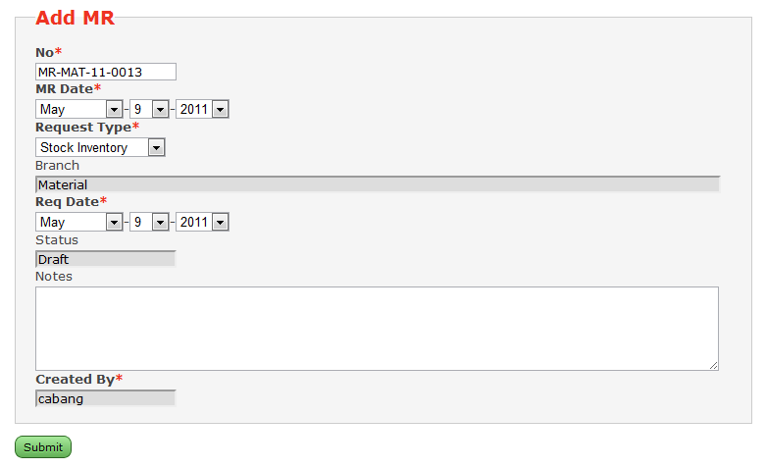
Input New PR
PR is originated by a Branch user who request either FA items or Stock Inventory Items (the Request Type).
User must fill the Notes which describe the purpose of the PR and why he need those items.

Slide 9
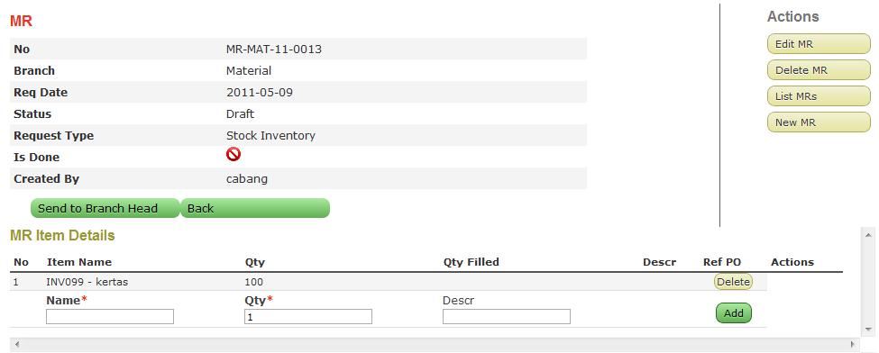
Input New PR
After filling the global information, then he choose the detail items requested and the quantity.
He then send the PR to the Branch Head for approval.

Slide 10
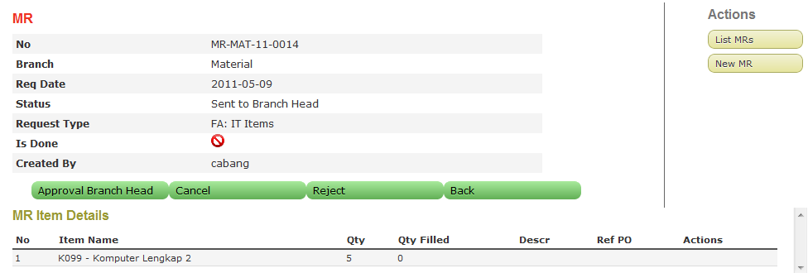
PR Approval
The Branch Head review and analyse the PR. He can Approve, Reject, or Cancel the PR.
Approved PR will automatically sent to the Head Office for further processing.

Slide 11
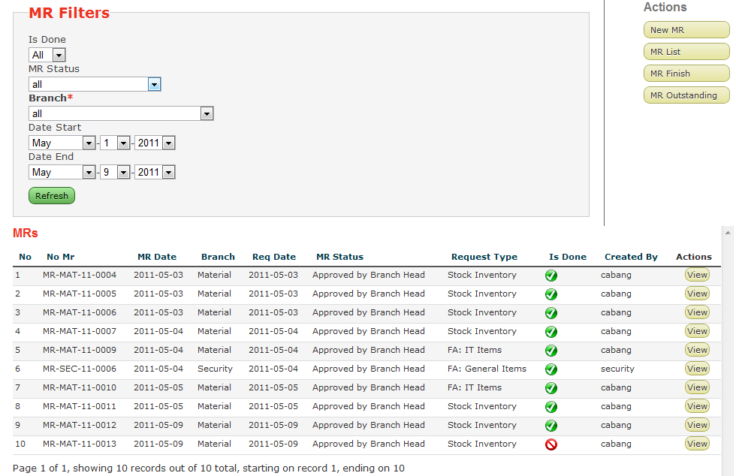
PR List
User at the Head Office can see the list or PR approved at the Branches, including the Type of Request.
Analysing it, he then can process the PR either by creating PO, FA Transfer, or Inventory Outlog depending the Request Type.

Slide 12
PO
Create from PR Item Details
Level Authorization
Input
Level 1
Level 2
Director (level3 + finish)
Multiple Currency
Multiple Payment Term
Notifications
Draft
Need Approval
Need to be Print
Need to be Sent to Supplier
Outstanding Receive (qty not fully received)
Outstanding Payment (payment terms not fully paid)

Slide 13
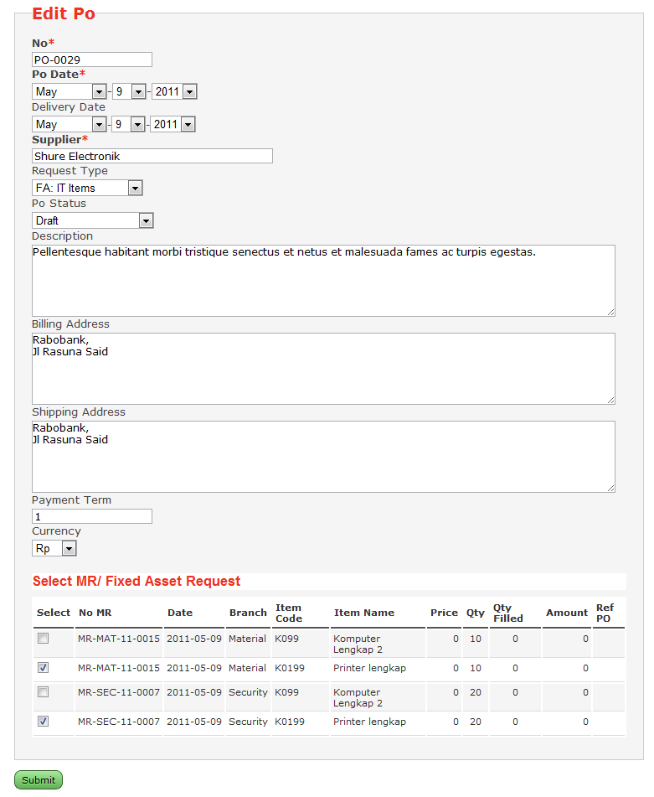
Input New PO
The Head Office user create PO, determine the Request Type, and select the PR’s items details with the same Request Type to be ordered in this PO.

Slide 14
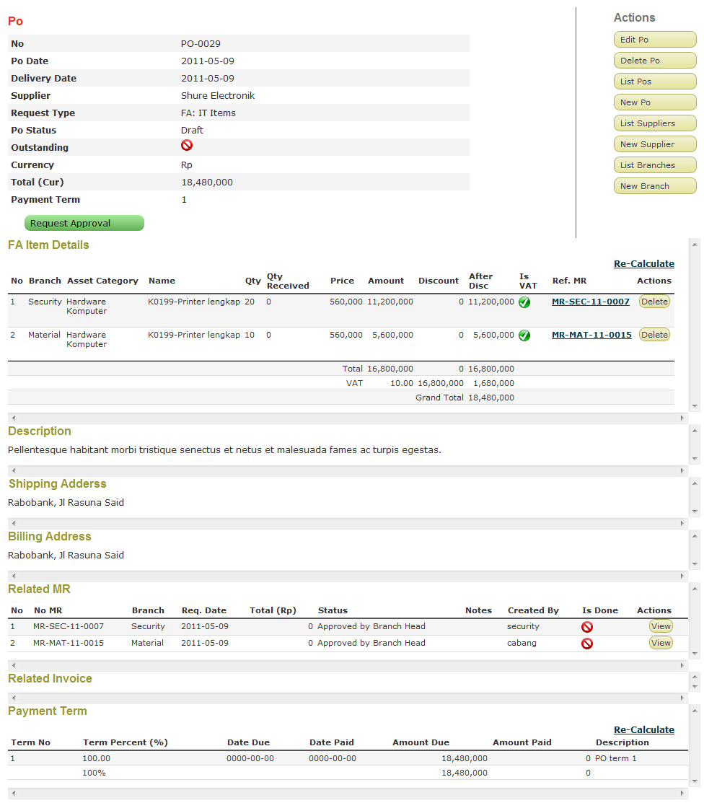
Input New PO
The PO Item Detail is created based on the PR’s item detail selection.
The user the enter the details, discount, tax,etc.
He can also enter the payment term information for the PO.
The user then send the PO for approval to the upper level user group.

Slide 15
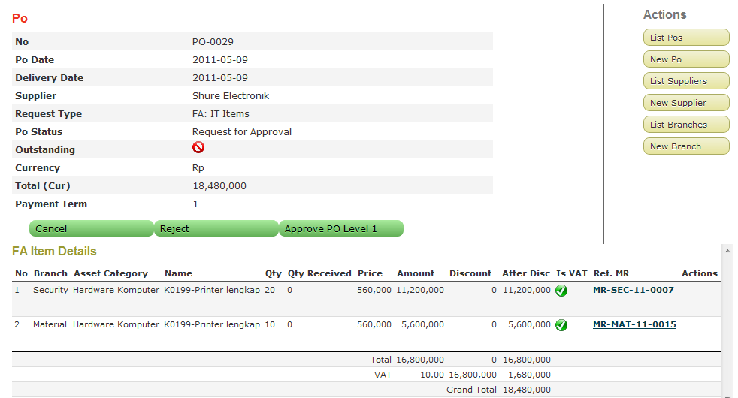
PO Approval
The assigned PO approval user can review the created PO where he can Approvel the PO according to his level of authorization, Cancel, or Reject the PO.

Slide 16
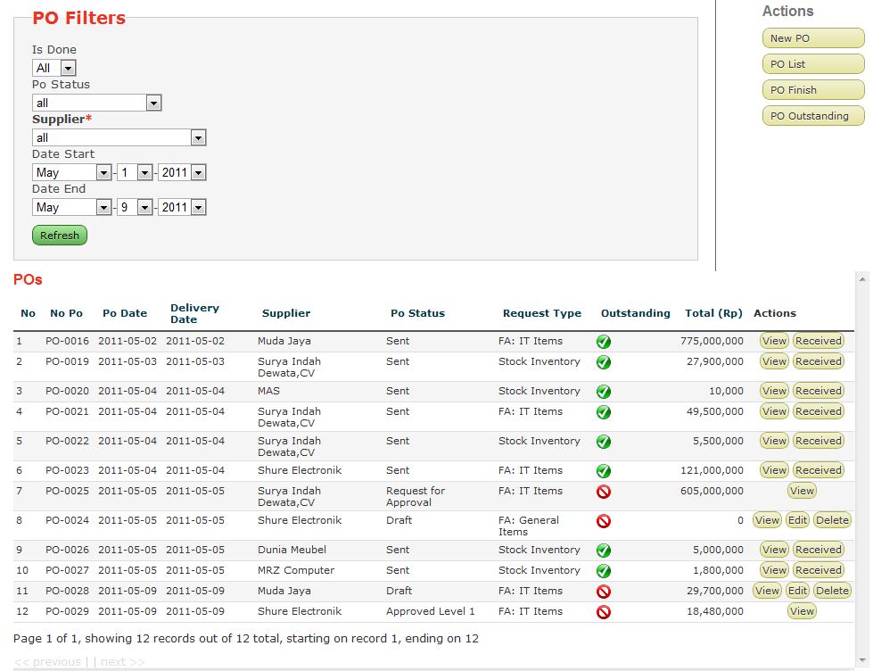
PO List
Depending on the authorization level of the users, they can view the list of POs with the status and other details.
From there, he can view the invoice and take further process.

Slide 17
DO
Create DO from PO upon Item Receive
Record Partial Item Recieve
Each DO can be converted into separate Invoice

Slide 18
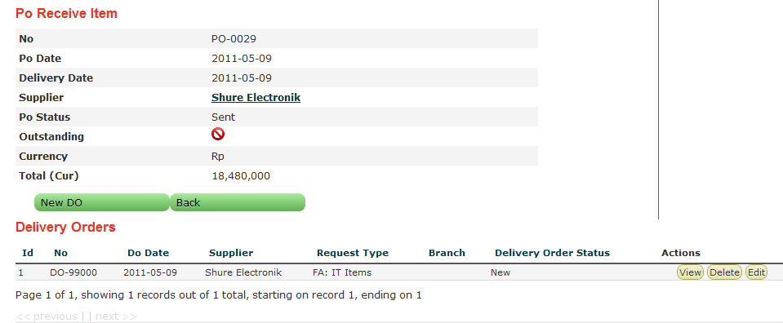
Create Delivery Order
When items ordered on a PO are received, the user open the PO and enter the DO information for that PO.

Slide 19
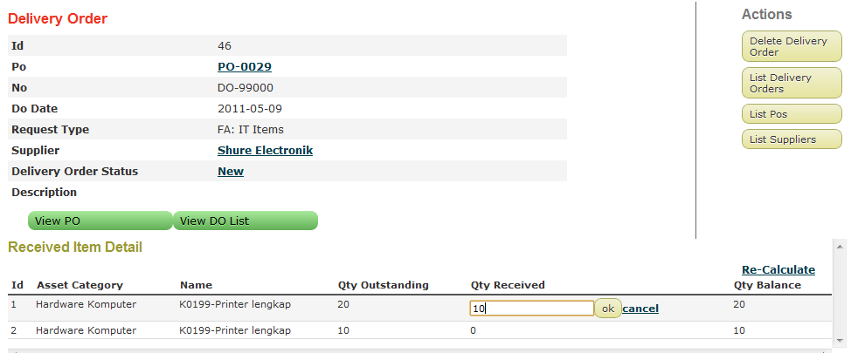
Create Delivery Order
The DO item details is created based on the PO item details.
The user enter the qty received for each item.
The user repeat the process each time the next items are being received if not all items are received at one time.

Slide 20
Invoice
Create Invoice from one or more PO
Notifications
New
Unpaid
Paid
Need to enter Receival Journal
Need to enter Payment Journal
Outstanding (unpaid)
Generate GL Journal
Receive Items
Invoice Payment
Control FA Depreciation Date

Slide 21
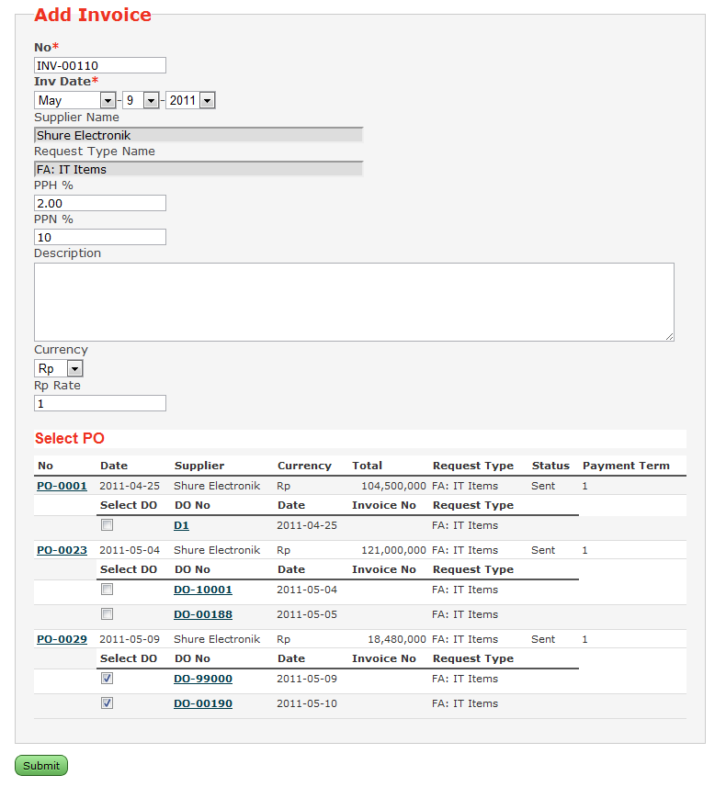
Input New Invoice
The invoice is created by Head Office users. He can select the PO and DOs which the item details is to be invoiced from.

Slide 22
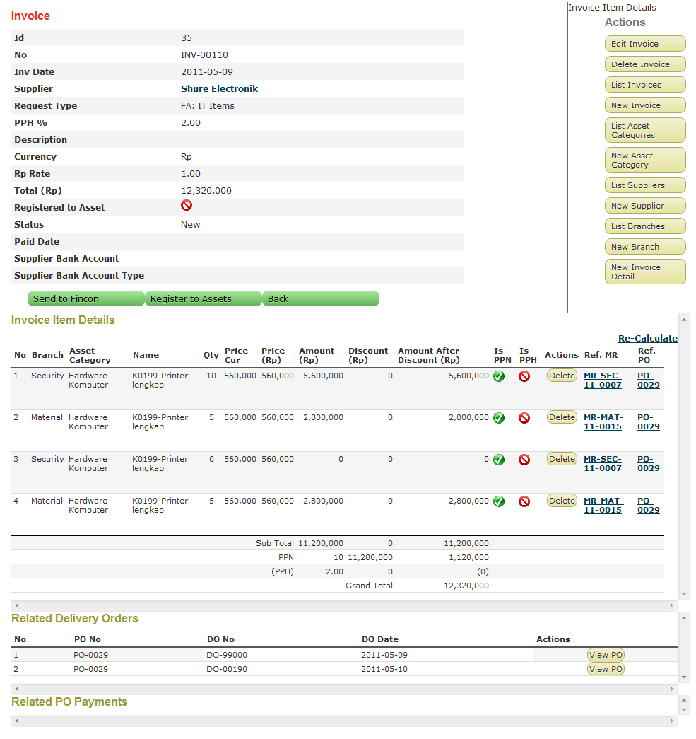
Input New Invoice
The Invoice item detail is created based on the DO selected. The user can send the Invoice to Financial user for further processing.

Slide 23
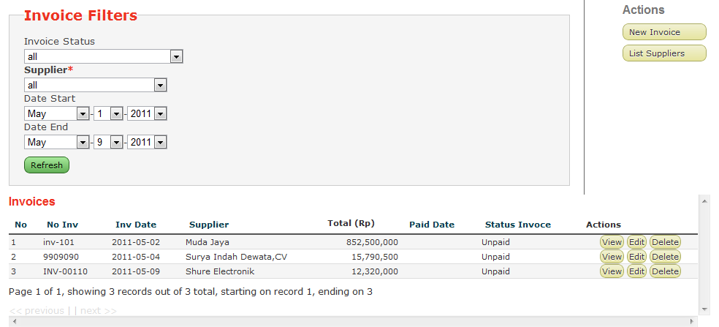
Invoice List
Depending on the authorization level of the users, they can view the list of Invoices with the status and other details.
From there, he can view the invoice and take further process.

Slide 24
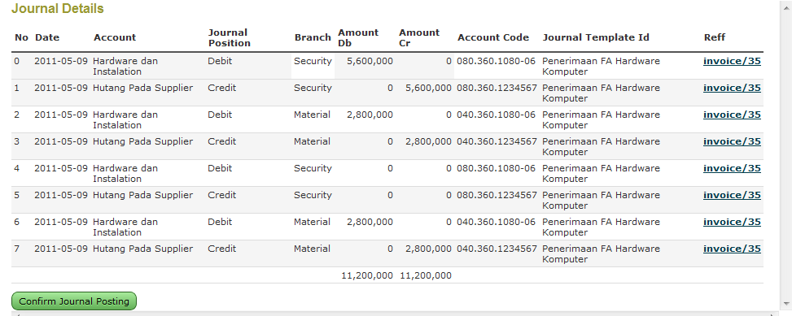
Receive Journal
The user can continue to posting Receive Journal for an Invoice.

Slide 25
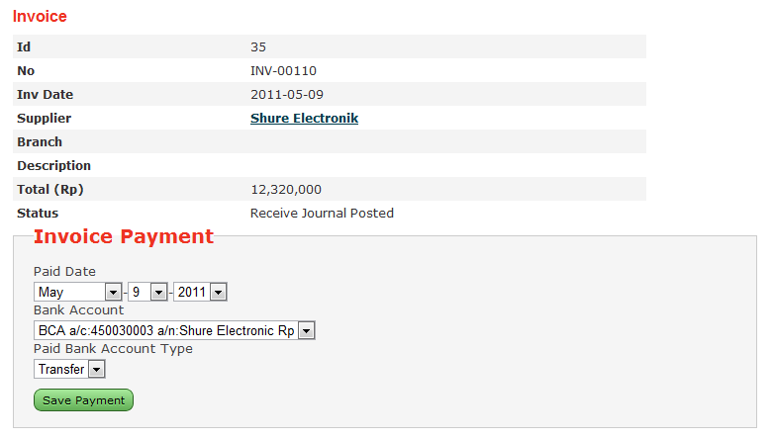
Invoice Payment
The User can enter the payment detail for the Invoice, based on the default Supplier’s payment information

Slide 26
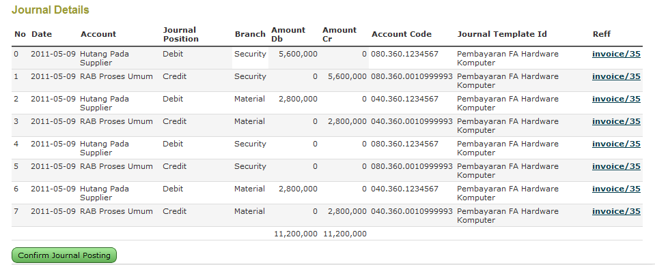
Payment Journal
The user can continue to posting Payment Journal for an Invoice and make it’s state to Done.

Slide 27

Fixed Asset Management
FA Registration
Direct
From Invoice, PO, PR
FA Transfer
Branch
Units
FA Disposal
Write off
Sales
FA Re-classification
Labeling/ Barcode
Physical Check
Import XLS
Amortization Process
Calculate FA depreciation
Generate GL Journal
FA Receive and Payment
Amortization Process
FA Transfer
FA Disposal
Reporting
Maintenance
History

Slide 28
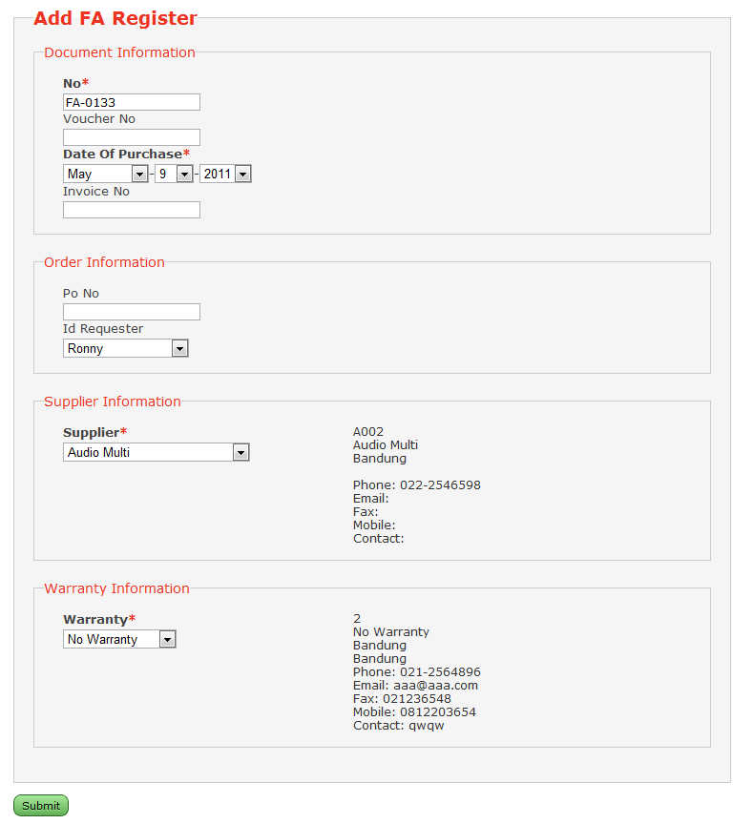
FA Registration
Two method of FA registration into the system:
Direct: for FA that is acquired without procurement process. For example, gifts, paintings, decorations, etc.
From Invoice, PO, PR : normal FA can be registered into the system though only Invoice, Invoice from PO, or complete procurement process from PR to PO to Invoice.

Slide 29
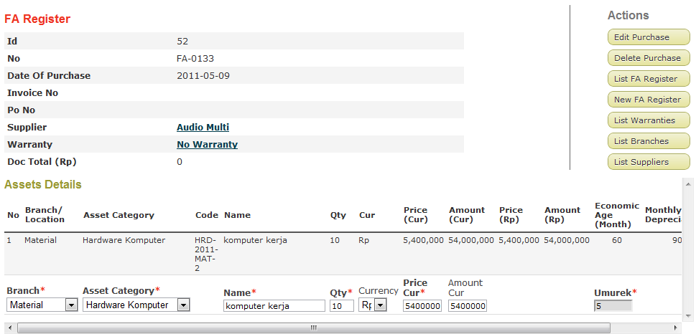
FA Registration
Entering the FA to register

Slide 30
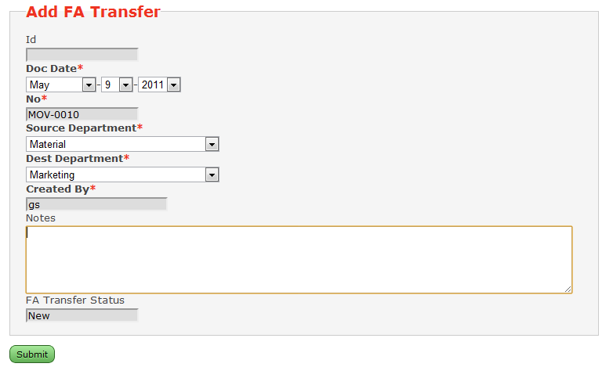
FA Transfer
Registered FA can be transferred to other Branches or other Unit at the same Branch.
Branch : there’s an accounting consequences in which the Source Branch will be credited and Destination Branch will be debited for the transferred FA
Units : there’s no accounting consequences for transferring FA to other Unit at the same Branch
Prior to FA Transfer processing, the document must be approved by the supervisor and an assigned user.

Slide 31
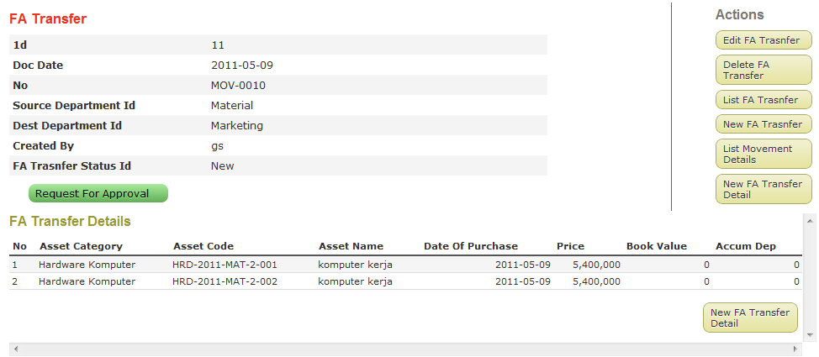
FA Transfer
Entering the FA details to transfer

Slide 32
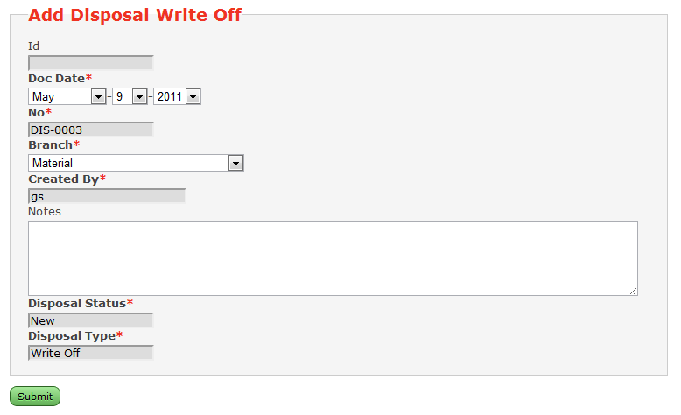
FA Disposal: Write Off
Registered FA can be disposed either as write off (scrap) or sales.
Write off
Sales
Prior to FA Disposal processing, the document must be approved by the supervisor and an assigned user.

Slide 33
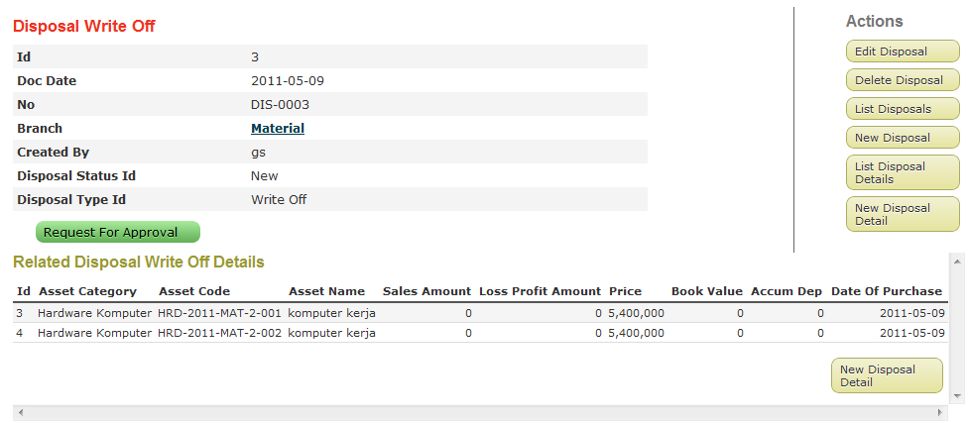
FA Disposal: Write Off
Entering the FA details to dispose

Slide 34
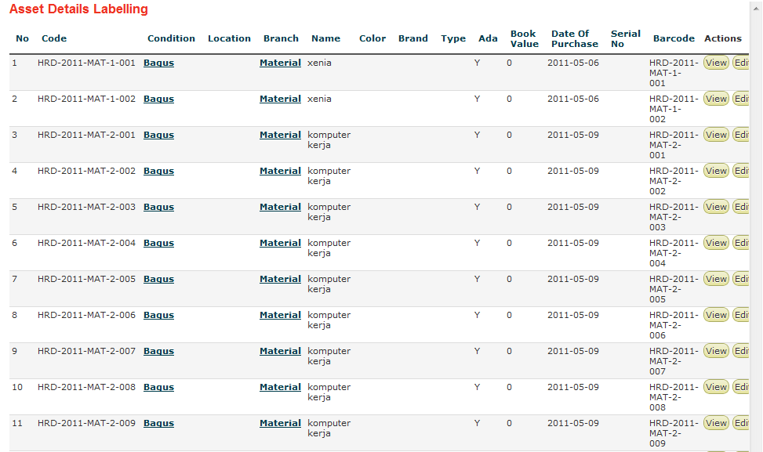
FA Labelling
FAMSYS can generate a printed list of Registered FA along with it’s barcode image. This is useful for labeling the physical FA with barcode label.

Slide 35
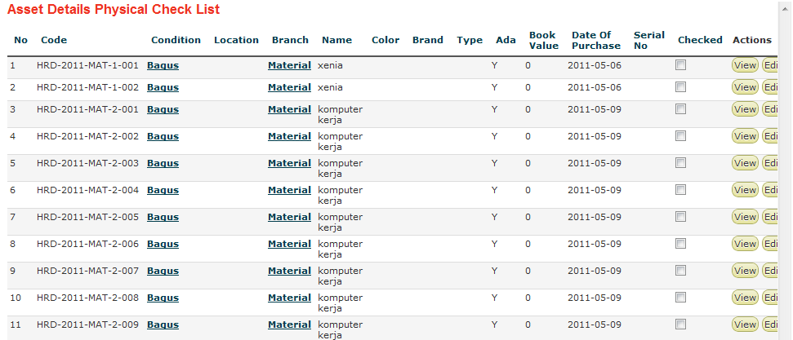
FA Physical Check List
Registered FA can be re-classed from it’s original Asset Category at the registration process into another Asset Category.
This process will have an accounting consequences, in which the original Asset Category account will be credited and the new Asset Category account will be debited.

Slide 36
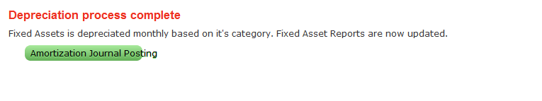
FA Depreciation Process

Slide 37
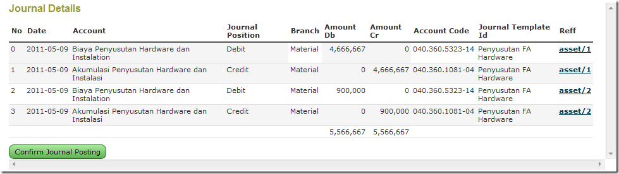
Generate GL Journal
FAMSYS can generate automatic GL Journal entries useful for exporting and posting to the external core GL Accounting System. This is usually done either by text file export or web services.
FAMSYS generate GL Journal for each of Asset Categories for these transaction related to FA management:
FA Receive
FA Payment
Amortization Process
FA Transfer
FA Disposal

Slide 38
FA Maintenance
This is to record maintenance activities applied to the FA.
Maintenance record is easy to maintain with FAMSYS because every FA are registered with the Warranty information.

Slide 39
FA History
This is to view the FA historical data from the date it was purchased, from who, the warranty, the purchase price, the transfers, the maintenance applied to the FA, until it is disposed.

Slide 40
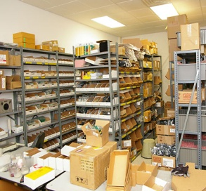
Inventory Management
Inventory Register
Direct
From Invoice, PO, PR
Inventory Distribution
Inventory Ledger
Inventory Status for Re-Order
Import XLS
Stock Inventory Reports

Slide 41
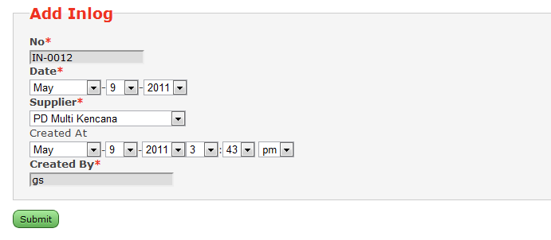
Inventory Register
Two method of Stock Inventory registration into the system:
Direct: for Stock that is acquired without procurement process.
From Invoice, PO, PR : normal Stock can be registered into the system though only Invoice, Invoice from PO, or complete procurement process from PR to PO to Invoice.

Slide 42
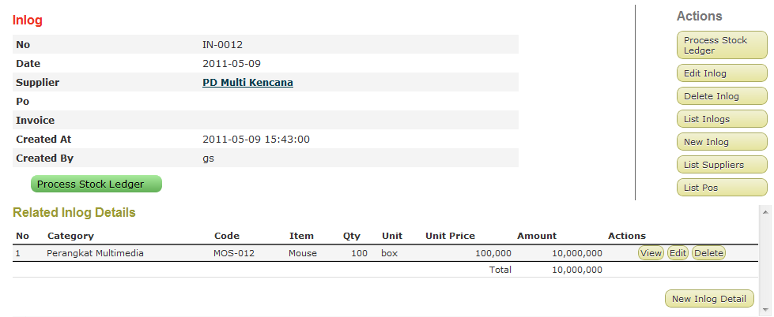
Inventory Register
Enter the inventory item detail

Slide 43
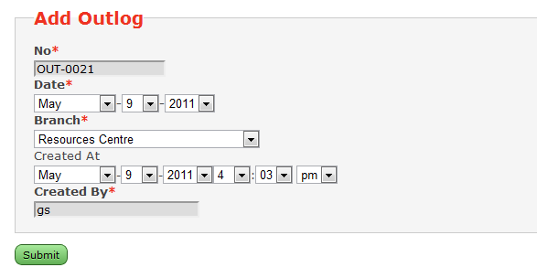
Inventory Distribution
Stock item requested by Branch is to be distributed by using the Outlog document.

Slide 44
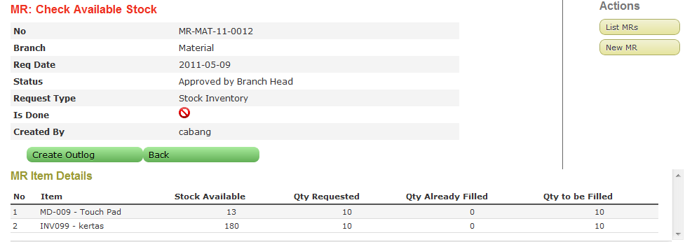
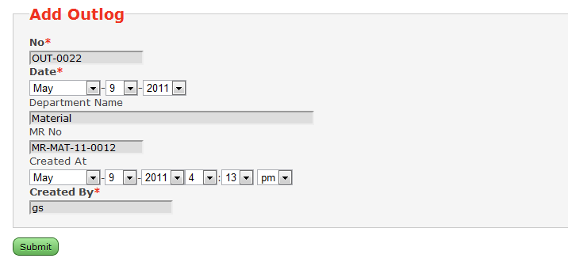
Inventory Distribution
Stock item requested by Branch is to be distributed by using the Outlog Document.
The Branch request begin with PR of type Stock Inventory. When the stock is available, then the Outlog Document is created based on the PR.

Slide 45
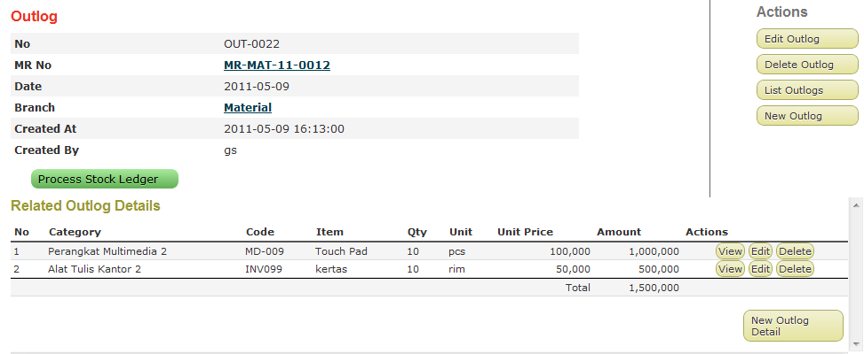
Inventory Distribution
Outlog Document detail will be filled automatically based on the PR detail

Slide 46

Inventory Ledger
This process it to calculate the movement and ending balance for each inventory items registered into the system and distributed to branches.

Slide 47
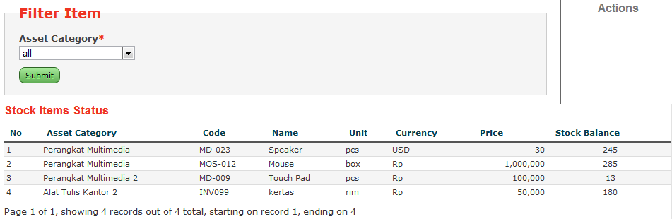
Inventory Status for Re-Order
This is the report showing the ending balance status for every Stock Inventory Items on the system. This will be the base for reordering the items through PO.

Slide 48
Import XLS
FAMSYS can import existing Stock Inventory data in the XLS format. This will make it easier to user to migrate the existing Stock Inventory into the system.

Slide 49
Auto Create GL Journal
FA Receival
FA Invoice Payment
FA Transfer
FA Disposal
FA Amortisation
Inventory Receival
Inventory Invoice Payment
Inventory Distribution
Customizable Journal Template for each transaction
Related Account
Positions (Debit, Credit)
Destination/ Source Branch
Sales Profit/Loss
Export to TXT file, Webservices

Slide 50
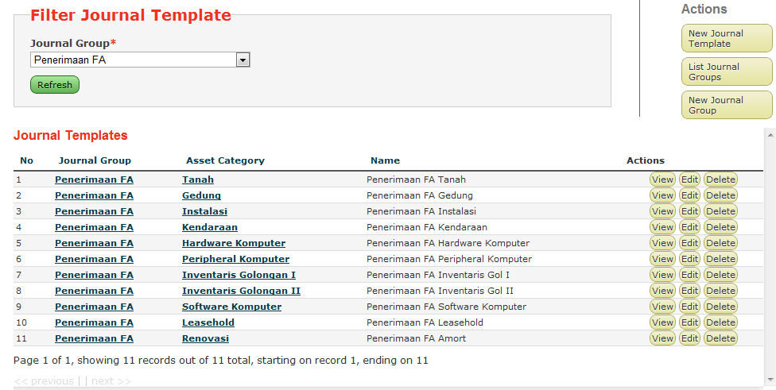
Provided Journal Template
FAMSYS already shipped with default Journal Templates for these transactions:
FA Receival
FA Invoice Payment
FA Transfer
FA Disposal
FA Amortisation
Inventory Receival
Inventory Invoice Payment
Inventory Distribution

Slide 51
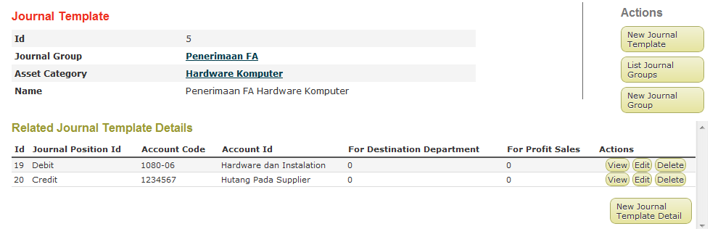
Customizable
Default Journal Template is customizable. You can change the accounts related to the transaction, create new Journal Template according to your business, etc.
For every Journal Template, you can define:
Related Accounts
Account Positions (Debit, Credit)
Destination/ Source Branch
Sales Profit/Loss

Slide 52
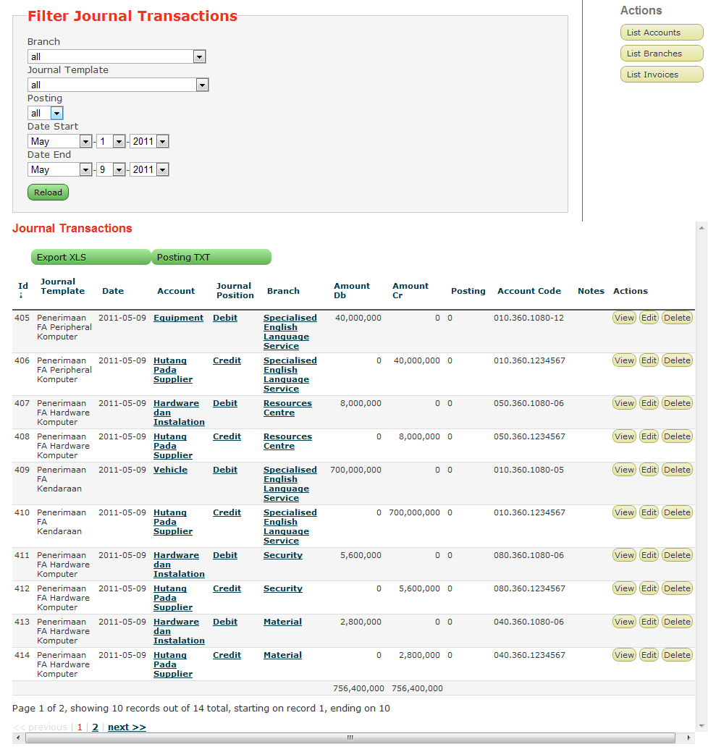
Export Journal Transaction
The FAMSYS can export the generated Journal Transaction to several file format (TXT, XLS) or accessing webservices to post the transactions.
The export TXT is commonly to be used for integration to the existing Core GL Accounting System.

Slide 53
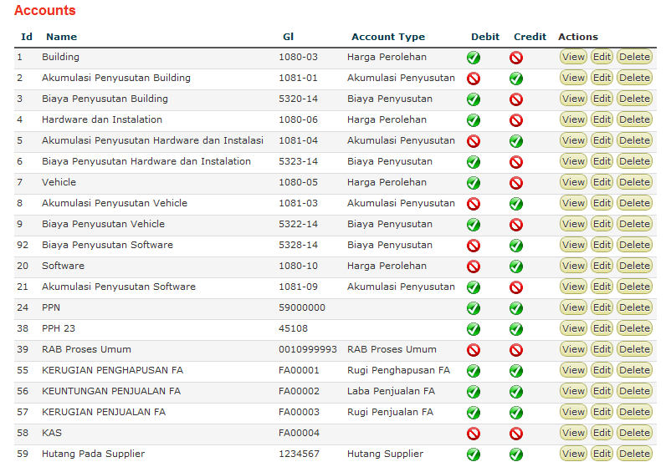
Accounts Management
All Accounts related to Journal Transaction template are customizable

Slide 54
Reports
On the fly Report Generation
Export to PDF, XLS, Word

Slide 55
Procurement Process Reports
PR
Outstanding
Finish
PO
Outstanding
Finish
Invoice
Outstanding
Finish

Slide 56
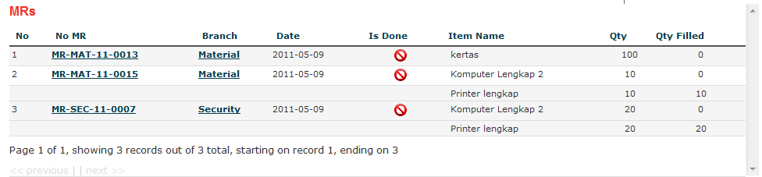
PR Reports
Outstanding: displays all PR that are still outstanding, all items requested are not fully delivered

Slide 57
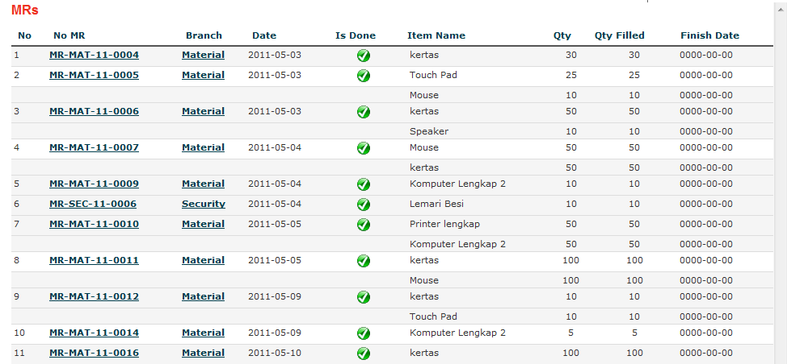
PR Reports
Finish: displays all PR that are done, all items requested are fully delivered

Slide 58
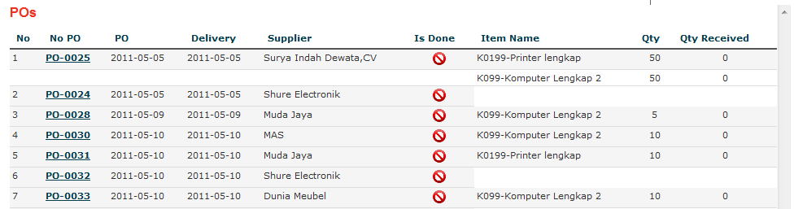
PO Reports
Outstanding: displays all PO that are still outstanding, all items requested are not fully received

Slide 59
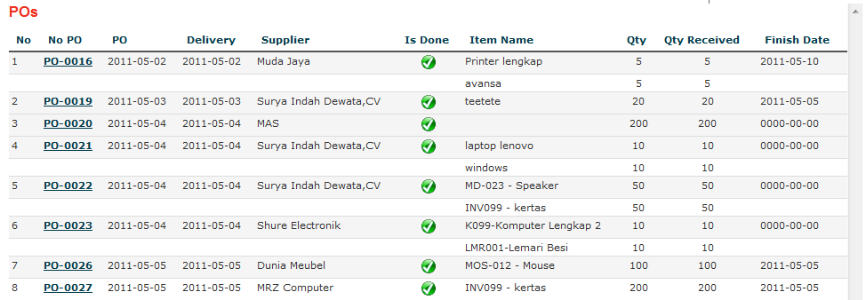
PO Reports
Finish: displays all PO that are done, all items requested are fully received

Slide 60
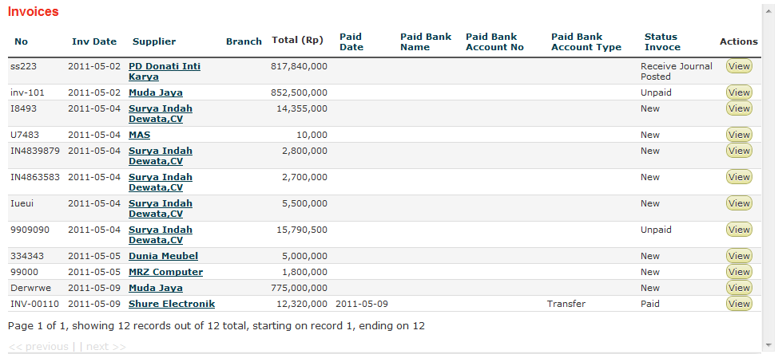
Invoice Reports
Outstanding: displays all Invoice that are still outstanding, items are not registered to Asset

Slide 61
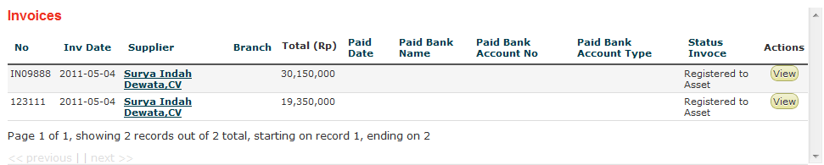
Invoice Reports
Finish: displays all Invoice that are done, items are registered to Asset

Slide 62
Reports: FA
Filter by End Date, Branch, Asset Category and Type
List Fixed Asset
Monthly Depreciation Report
Monthly Detail Depreciation Report
Depreciation Recap Report
Detail Report
Monthly Depreciation Recap
Register Report
Asset Transfer Report
Movement Report

Slide 63
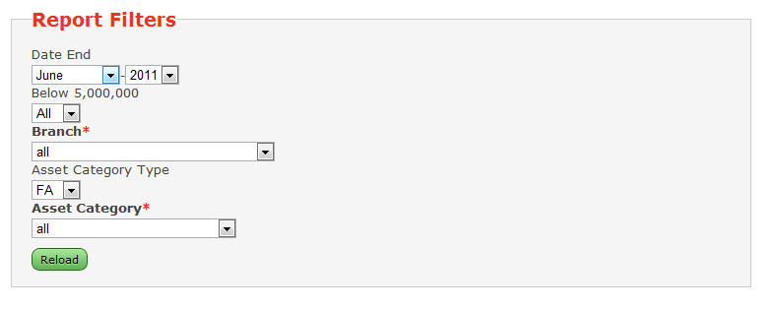
Fixed Asset Report Filters
Every Fixed asset Reports have filters that can be choosen to find the specific asset

Slide 64
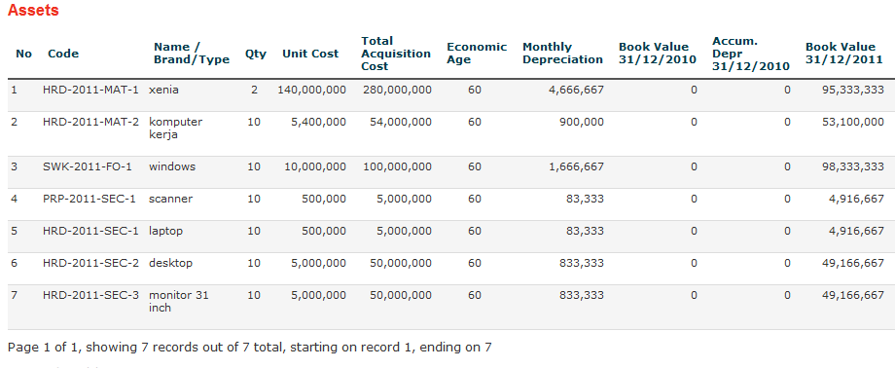
List Fixed Asset
Displays currently registered fixed asset globally

Slide 65
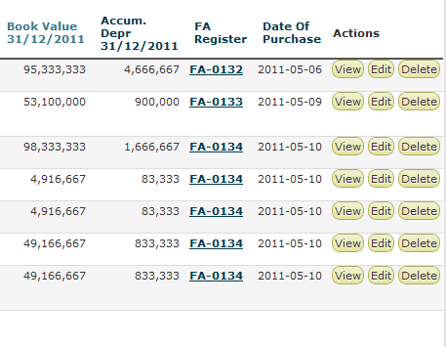
List Fixed Asset
Displays currently registered fixed asset globally

Slide 66
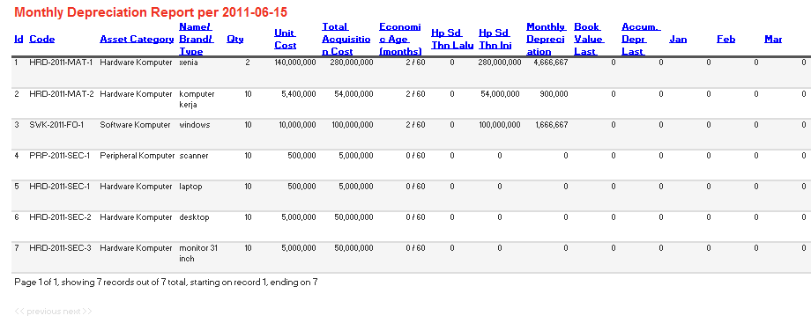
Monthly Depreciation Report
Display currently registered fixed asset globally, with monthly depreciation, and current accumulated depreciation, and book value

Slide 67
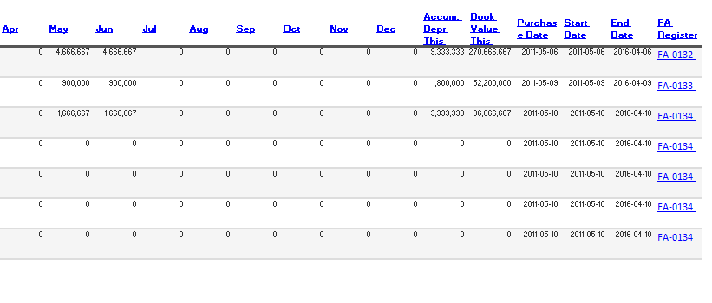
Monthly Depreciation Report
Display currently registered fixed asset globally, with monthly depreciation, and current accumulated depreciation, and book value

Slide 68
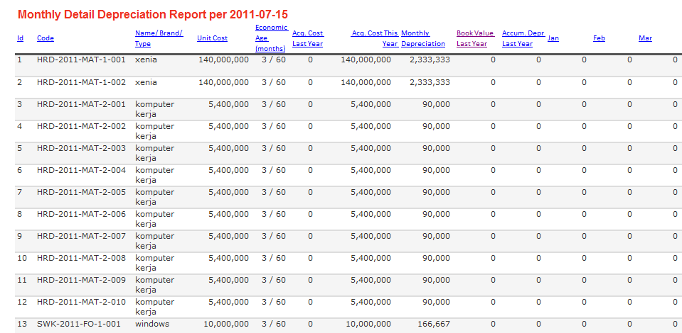
Monthly Detail Depreciation Report
Display currently registered fixed asset in detail, with monthly depreciation, and current accumulated depreciation, and book value

Slide 69

Monthly Detail Depreciation Report
Display currently registered fixed asset in detail, with monthly depreciation, and current accumulated depreciation, and book value

Slide 70

Depreciation Recap Report
Display currently registered fixed asset globally recapitulate and grouped by asset category

Slide 71

Detail Report
Display currently registered fixed asset in detail briefly with current accumulated depreciation, and book value

Slide 72

Monthly Depreciation Recap Report
Display currently registered fixed asset globally recapitulate and grouped by asset category, with monthly depreciation values

Slide 73

Movement Report
Display currently registered fixed asset globally recapitulate and grouped by asset category, splitted for acquisition cost ..

Slide 74

Movement Report
.. Accumulated depreciation , and ..

Slide 75

Movement Report
.. The final book values

Slide 76

Register Report
Display currently registered fixed asset globally by their registration document number (purchase document)

Slide 77

Asset Transfer Report
Display currently registered fixed transfer history

Slide 78
Reports: Stock Inventory
Item Inlog
Item Outlog
Item Movement
Item Stock Status
Inventory Ledger
Item Orders
Global Item Usage per Periode
Monthly Item Usage per Branch

Slide 79
Document Workflow

Slide 80

User/Group/Module Access Control
Groups of Users can have a defined PO authorization limit ...

Slide 81

User/Group/Module Access Control
Menus they can access

Slide 82

User/Group/Module Access Control
And who are in that group

Slide 83

Suppliers Data Management
Track History, Black List, Matrix

Slide 84


Parameterized System
System parameters are user configurable

Slide 85
Specification
OS:
Linux / Windows
Database:
MySQL / MS SQL
Programming Language:
PHP5

Slide 86

System Architecture
Centralized System
IP Based Network
Web Based Application
Client and Server can
Run on Linux/Window

